Slide 1
Introduction To
Web Servers
Presentation For Ahvaz LUG
Sep 22nd, 2017
http://ahwlug.ir
https://sadegh.io

Slide 2
Basics

Slide 3
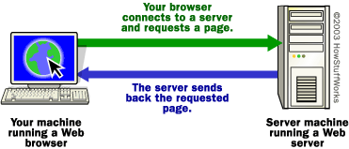
What Is A Web Server?
Basically, a web server is a software that runs and listens to specified port(s) for incoming requests, process them or pass them to other applications and send back the results.

Slide 4
Working
Web server responds to the client requests in either of the following two ways:
Sending the file to client associated with the requested url
Generating responses by invoking a script and a communicating with database

Slide 5
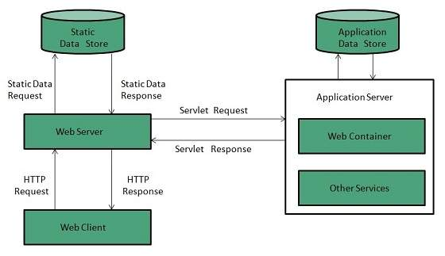
Diagram

Slide 6
NOTICE:
When client send request for a web page, web server searches for the requested page and if the web server found that, it will send it to client with a HTTP response.
If the web server could not find anything, it responds with “404, Not found”
If the client requested some other resources then the web server contacts the application and sends the result in HTTP response

Slide 7
Architecture
Single-Process-Event-Driven Approach (SPED)
Cuncurrent Approach:
Multi process
Multi threaded
Hybrid Method: It is a mixture of above options

Slide 8

Multi-process

Slide 9

Multi-threaded

Slide 10
Proxy Server

Slide 11
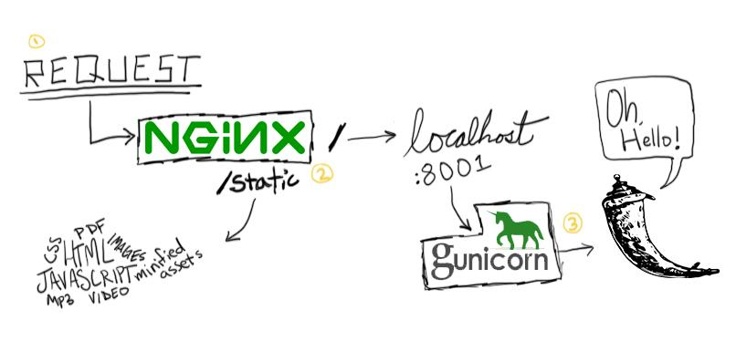
Proxy Server

Slide 12
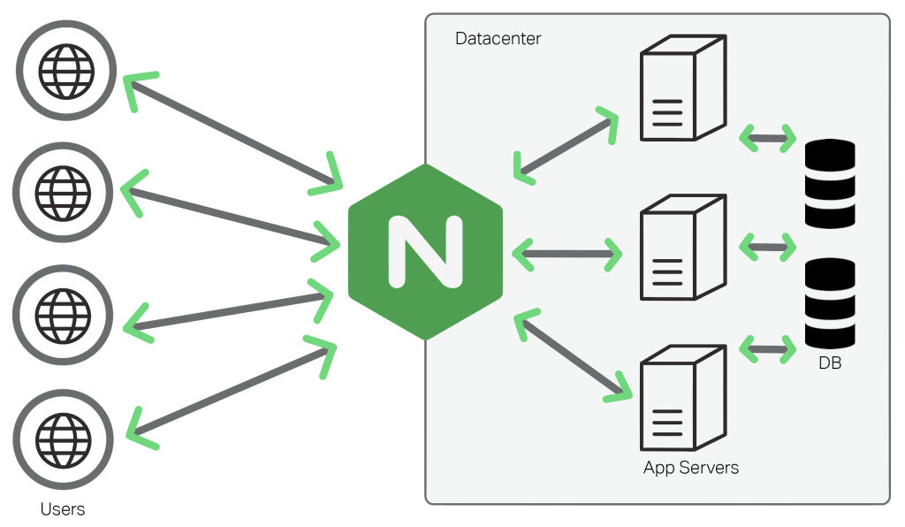
Proxy Server

Slide 13
Load Balancing

Slide 14
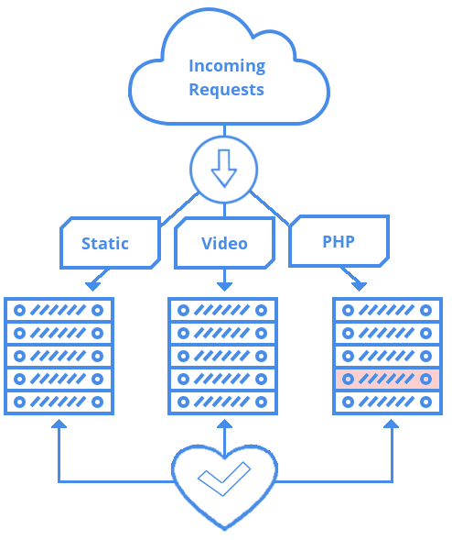
Load Balancing

Slide 15
Designing Cloud Applications

Slide 16
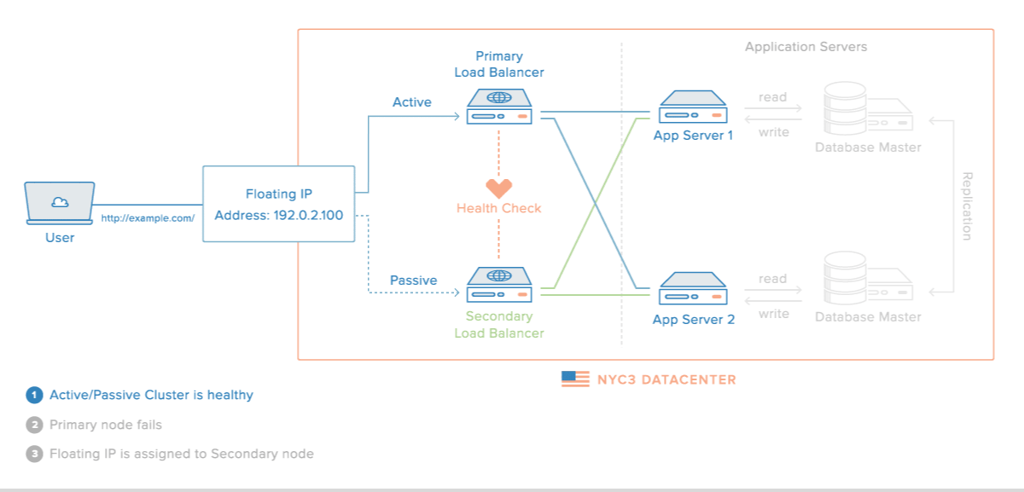
Design For High Availibility

Slide 17
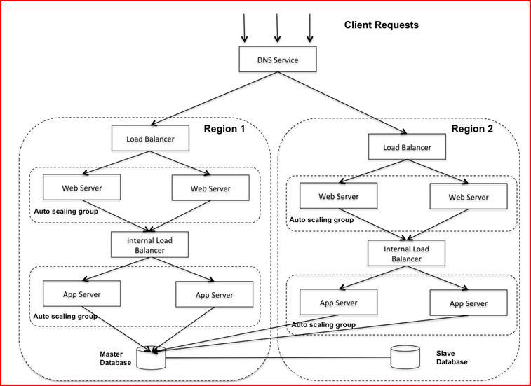

Slide 18
“There Are Web Servers And Then There Is Nginx”
- From a geek

Slide 19

Thanks!
Contact us:
sadegh@sadegh.io
https://sadegh.io
Link to Google Slides:
https://bit.ly/AhwLugEP5

